Slide 1
Vendor Agnostic Blob Storage Solution
20 May 2022
Ashutosh Kumar Pandey
Tanu Sri Kurakula
Ria Kapoor
Nandini Dewra
Shubhangi Singh

Slide 2
Contents
Problem Statement
Approach
Outcomes-Demo
What did we learn
References

Slide 3
Problem Statement
We are in the process of moving our services from on-prem solution to Azure cloud. In this context, some services are using S3 API to communicate with Storage Grid solution. However, Azure Blob does not use S3 API. This is a migration challenge hence, we want to evaluate Apache Jclouds as one of the solution to build vendor agnostic Blob Storage solution within Blackrock.
Technologies :-Java, Jclouds, S3 API

Slide 4
Approach:
Write Java code to create containers, upload blobs, delete containers
Connect to storage grid using S3 SDK​
Connect to storage grid using Jclouds​
Connect to Azure Blob using Jclouds ​
Evaluate support for the following using Jclouds.
Uploading objects using multipart upload.
Sharing objects using pre-signed URLs.

Slide 5
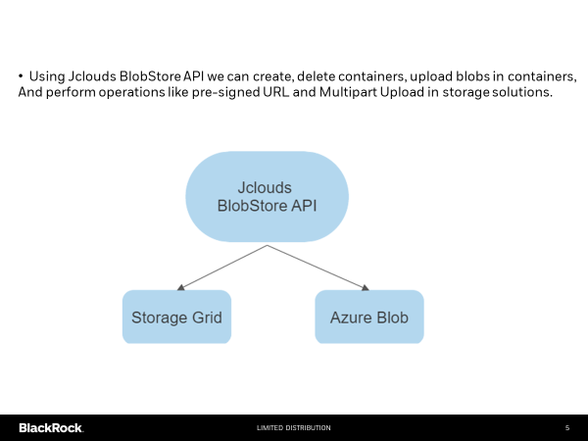

Slide 6
BlobStore
A BlobStore is a key-value storage service, such as Amazon S3, where your account exists and where you can create containers and blobs .
A container is a namespace for your data and storage account can have multiple containers.
Inside your container, you can store data as a Blob referenced by name
Key points about blobstores:-
Key/value data storage with metadata
Accessed via HTTP

Slide 7
Apache Jcloud
BlobStore API:-
The BlobStore API is a portable means of managing Key-value storage providers such as Microsoft AzureBlob Service, Amazon S3 or OpenStack Storage. It offers a synchronous API to our data
Features:-
Location Aware
Integration with non-java Clients

Slide 8
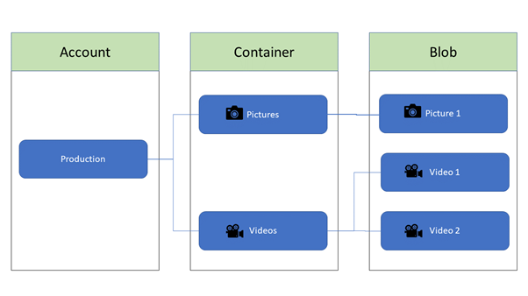
First we need to create an account in storage grid /azure storage and save the access keys.
Then using access keys we can communicate with storage grid/azure storage using BlobStore API to create/delete containers, add/delete blobs

Slide 9
Multipart Upload
Multipart Upload is allowing a single object to be uploaded as set of parts
After all parts are uploaded storage solution present the parts as a single object.
We can upload the parts parallelly which reduces the upload time.

Slide 10
Pre-signed URL
Pre-signed URL is a generated URL which is used to access the object for which the URL is created.
Unauthorized users can access the object via pre-signed URL provided that the creator of this object has the access to that object.
These URL’s are valid only for the specific duration.

Slide 11
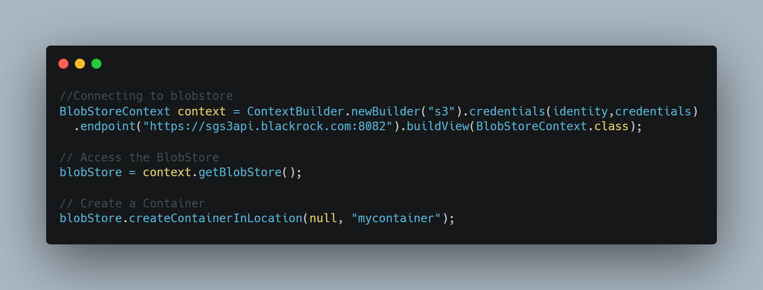
Connecting to BlobStore

Slide 12
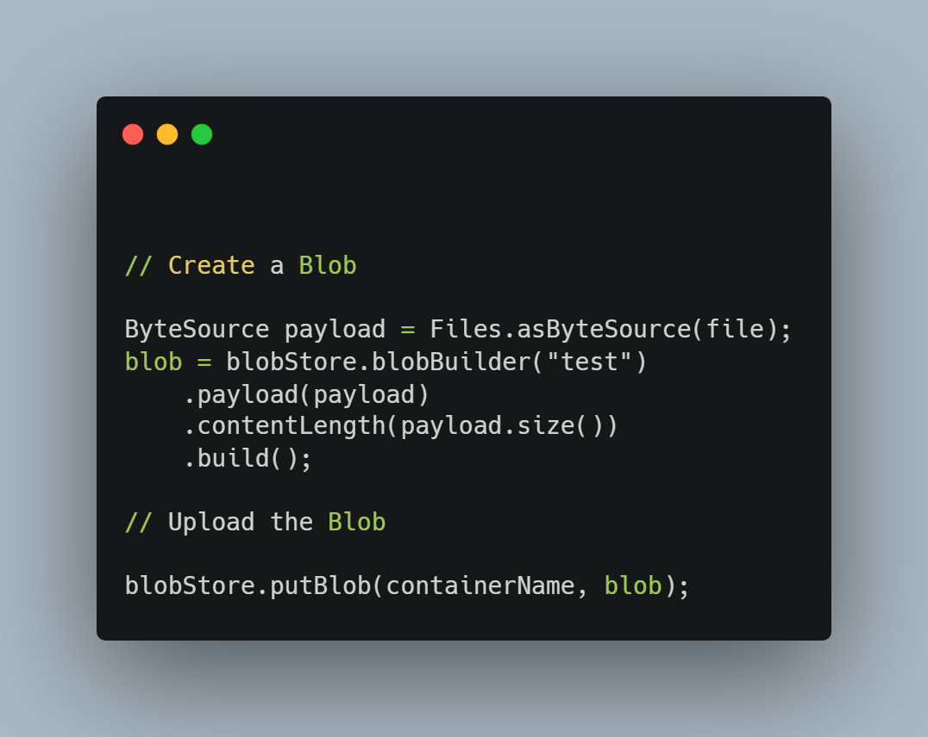
Creating a blob

Slide 13
Demo

Slide 14
What did we learn
Hands-on experience in various technologies. A good learning experience in this field.
Learnt differences between Object storage vs file storage vs block storage .
Benefits of object storage
Connect to various storage solutions using Jclouds Blobstore API.
Benefits of MultiPart upload
Sharing objects using Pre-signed URL
Built an understanding of how a team works and the challenges that come with it.​

Slide 15
Credits & References :
Special Thanks to our mentor Amrish Pande for guiding us
We also want to thank our respective functional teams for conducting demo and for the valuable feedback .
Some references:-
https://jclouds.apache.org/start/blobstore/
https://jclouds.apache.org/guides/azure-storage/
https://docs.aws.amazon.com/AmazonS3/latest/userguide/ShareObjectPreSignedURL.html
https://www.baeldung.com/2013/04/04/multipart-upload-on-s3-with-jclouds/
https://www.netapp.com/data-storage/storagegrid/what-is-object-storage/

Slide 16


